Slide 1
HEART DISEASE
Machine Learning Integration
Improving heart health
By: Prisca & Mehrin

Slide 2

OVERVIEW
Our Inspiration
Concept
Data Collection & Libraries
Process
Visualizations/Demo and insights
Conclusion
Questions
Resources

Slide 3
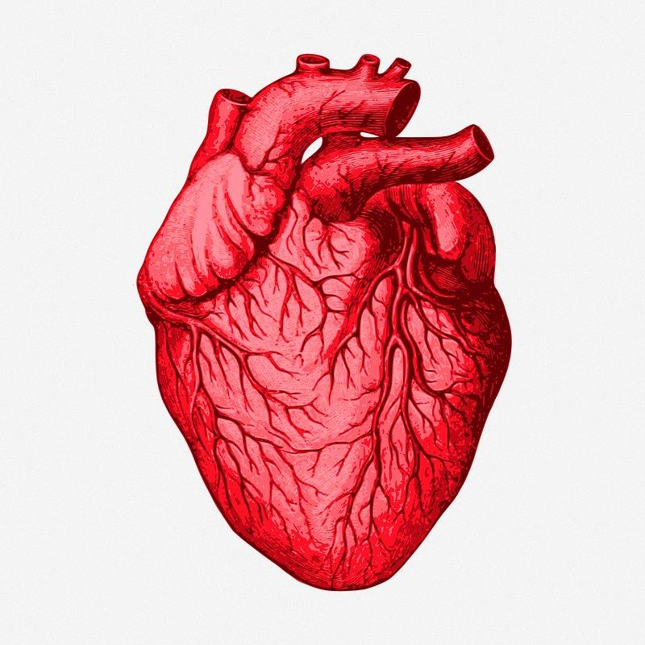
INSPIRATION
Our objective is to create a machine learning model for detecting patients that are at-risk for heart disease by focusing on various causative attributes, aiming to predict early signs of heart disease to identify individuals at risk. Analyzing relevant data allows us to anticipate and catch potential issues early on based on specific variables or features, improving health outcomes and ensuring efficient use of healthcare resources. Health care professionals will provide recommendations for managing and reducing the risk of heart disease, including lifestyle modifications and preventive measures, to improve overall health and minimize disease risk for at-risk patients.

Slide 4

CONCEPT
DATA
Gather patient data for predictive analysis.
USABILITY
To provide healthcare professionals easy access to utilize predictions seamlessly.
Provide actionable insights and recommendations based on model prediction.
TECHNOLOGY
Use Machine Learning (ML) to process the data and make predictions based on patient medical history.
INTEGRATION
Integrating model predictions into the healthcare system workflow.

Slide 5
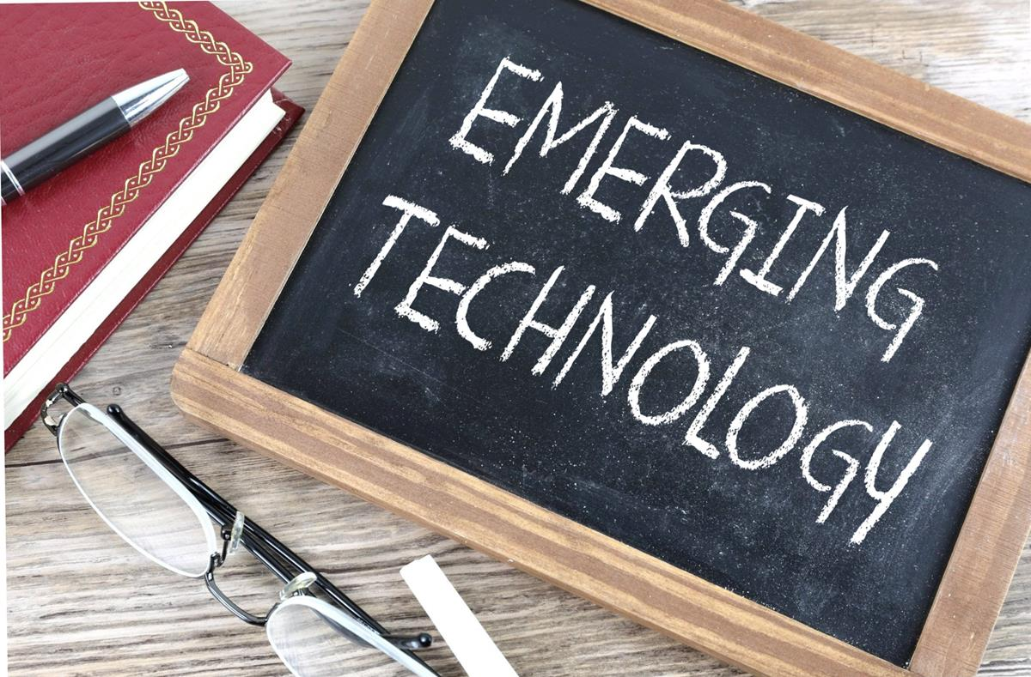
DATA SOURCE/ TECHNOLOGY
Data source:
Tools and Libraries:
Python Pandas
Scikit-learn
Python Matplotlib
scikit-learn
m_jlib
Flask
HTML/CSS
Tableau

Slide 6
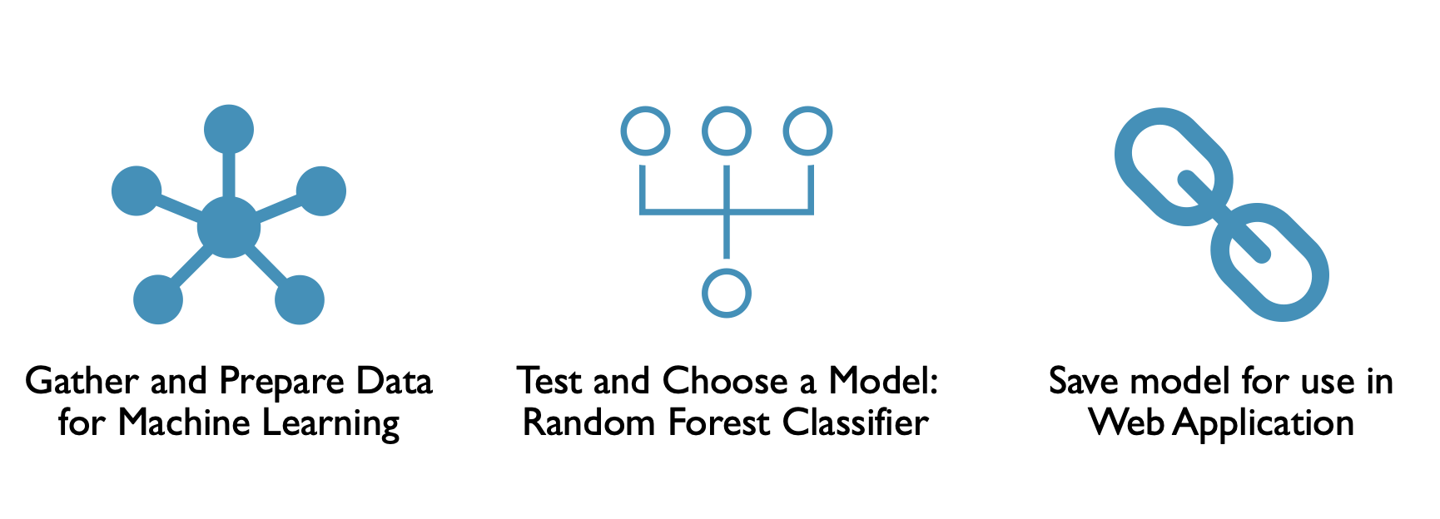
PROCESS
Notes:
Data collection: Data was collected from Kaggle
Data Preprocessing Data was prepared for further analysis. This includes:
Applied feature scaling to transform numerical features into a consistent range
Adding new columns into DF
Divided data into training and testing sets using train_test_split module
Modeling Training:

Slide 7
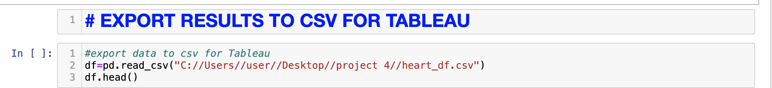
VISUALIZATIONS/DEMO
Tableau Visualizations:
https://public.tableau.com/app/profile/mehrin.khan/viz/HeartDisease_17074856563830/HEARTDISEASEDASHBOARD#1
Model Demo:
http://127.0.0.1:5501/Templates/index.html
Notes:
Model Deployment with Flask
Implemented the model logic in our home route to handle incoming requests
Created Web-based UI with HTML and CSS

Slide 8
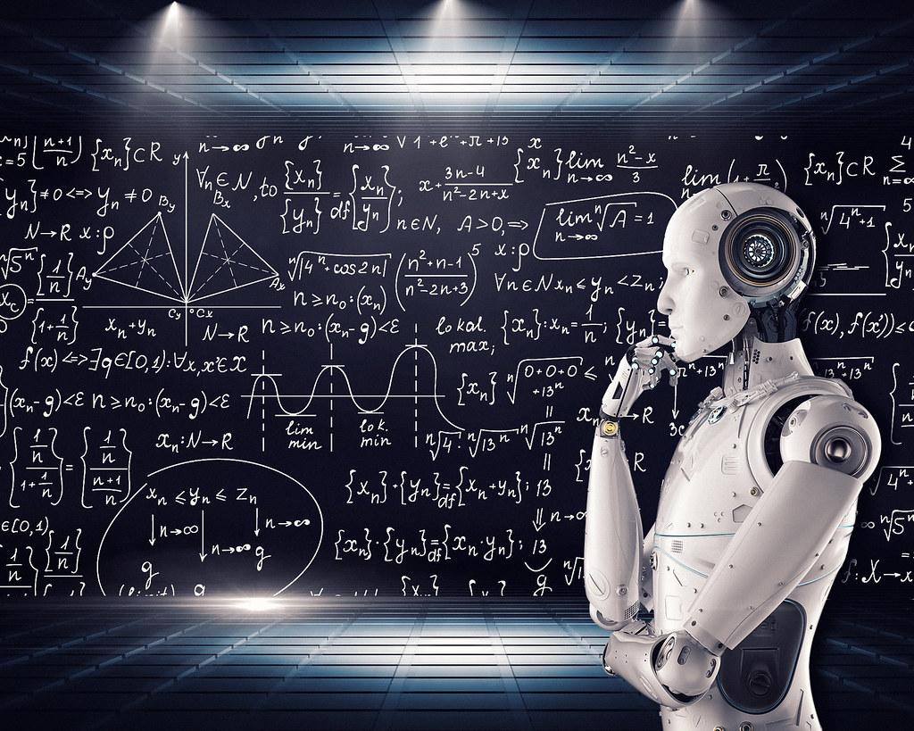
SOLUTION/CONCLUSION
Mapping out the predictions worked well.
We were able to get some interesting insights for other correlations as well.
This model offers opportunities to make suggestions for additional problems within the healthcare sector.

Slide 9
Thank you! Questions?

Slide 10
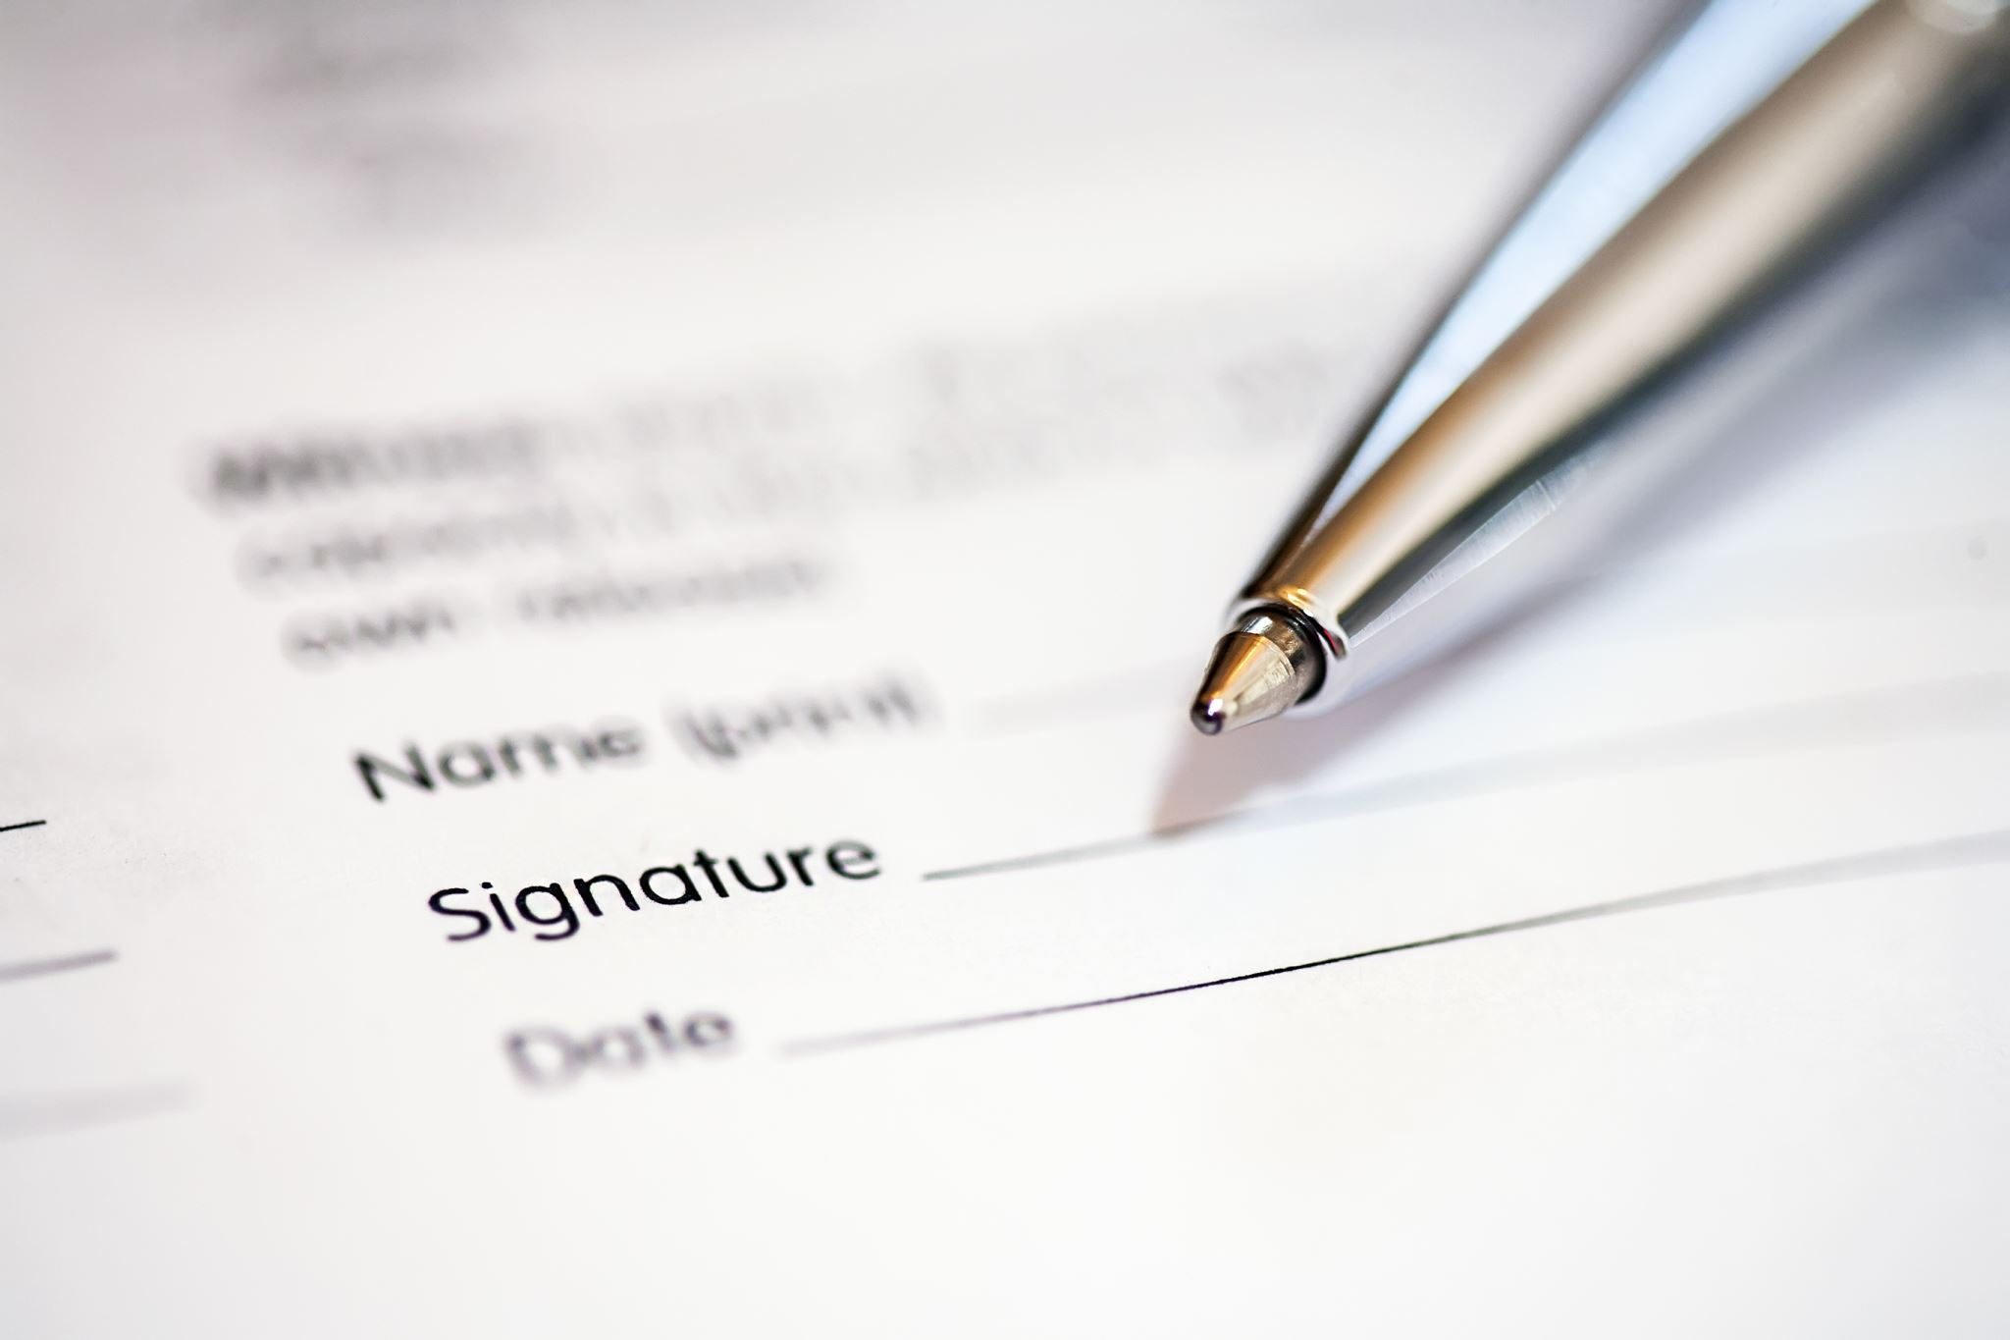
APPENDIX REFERENCES/RESOURCES
Our GitHub Repo: https://github.com/Prisca92/Project-4-final
Data collection: (https://www.kaggle.com/datasets/fedesoriano/heart-failure-prediction/data)
Coding Resources:

